Slide 1

DEMYSTIFYING DYING
UNDERSTAND THE TIPPING POINT

Slide 2

Disclaimer slide
Disclaimer: This educational program is provided for informational purposes only. While we strive to ensure accuracy and relevance, we do not guarantee or endorse any modifications, interpretations, or adaptations made by third parties. Any changes or additions to the program's content are the sole responsibility of those making such modifications.
We are not liable for any statements, representations, or advice offered by individuals who use or adapt this material. Users assume full responsibility for their interpretation and application of the content. By accessing this program, you acknowledge and agree that the original creators and providers are not responsible for any errors, omissions, or outcomes resulting from third-party use.
For official guidance or verification, please refer to qualified professionals in the relevant field.

Slide 3


Starting Off
Options:
  Reflection Question
  Reactions to the chapter

Slide 4



ASSUMPTION
REALITY
REALITY
  Dying comes suddenly
  Dying is agonizing
  Comparing decimals by using a place value chart
  Comparing decimals by using symbols
  Dying happens over time
  Dying can be peaceful
Hope is grounded in realistic information (this is the header)
  Hope evolves

Slide 5

WHAT IS DEMYSTIFYING DYING?
Dying is a chapter in life that usually unfolds over a period of time and gently. There are usually predictable features of this end chapter. But there are also a lot of misconceptions about how ordinary dying unfolds.
ACTION: Tap into resources and supports that help people at this end stage. Knowing what to expect and what ordinary dying looks like will give patients and families more control. They can plan and choose how they want to spend their time.

Slide 6

WHAT IS DEMYSTIFYING DYING?
Youtube Playlist: https://youtube.com/playlist?list=PLa1_77g2uuw1ffwoBtLmb7Wb8wPFNgo2Z&si=L2Gb4eZqTCpmCAmC
Notes:
Youtube Playlist: https://youtube.com/playlist?list=PLa1_77g2uuw1ffwoBtLmb7Wb8wPFNgo2Z&si=L2Gb4eZqTCpmCAmC

Slide 7

DEMYSTIFYING DYING
UNDERSTAND THE TIPPING POINT
Benefits
  Less fear and anxiety
  More time to find peace
  More time to prepare
  More time doing things that matter most
  Less unwanted or unnecessary care

Slide 8
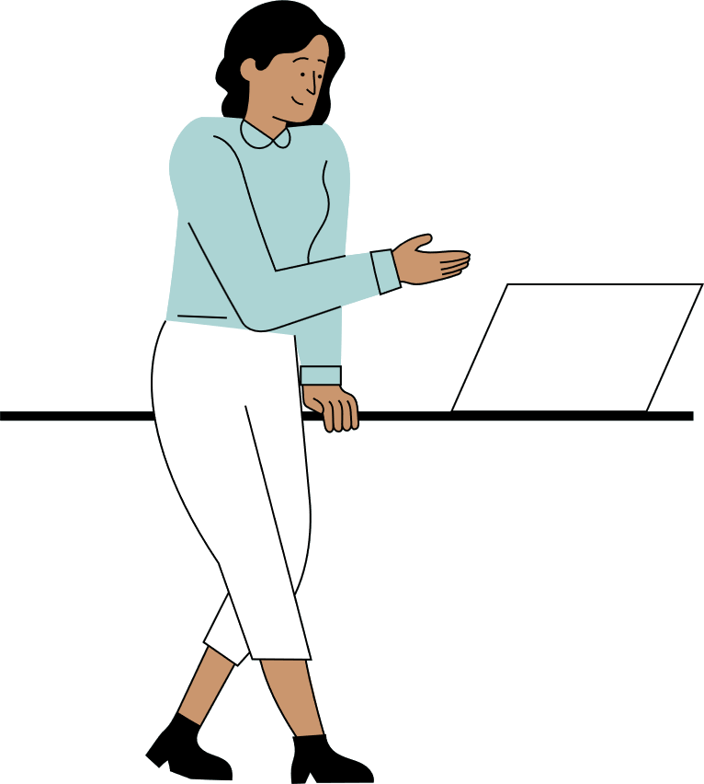
DEMYSTIFYING DYING
UNDERSTAND THE TIPPING POINT
Applying the Key
  What supports or services are available in the community to help in their illness journey? How do they access those services?
  Debunk myths about dying (refer to book)
  Discuss questions people have around palliative care
  Discuss grief and bereavement
  Discuss legacy leaving project ideas

Slide 9

DEMYSTIFYING DYING
UNDERSTAND THE TIPPING POINT
Summary
  Add to My Big Picture*
  Commitment to action
  Poll

